Slide 1
DATA -PREPROCESSING

Slide 2
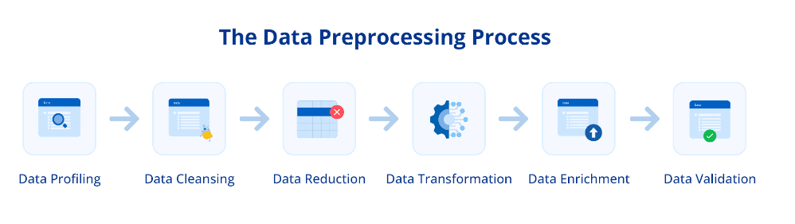

Slide 3
DATA PROFILING
Understanding your data is the first step in preprocessing.
Data profiling involves examining the data using summary statistics and distributions to understand its structure, content, and quality.
This step can reveal patterns, anomalies, and correlations crucial for informed preprocessing.
Example: A retail manager analyzes a dataset of customer purchases to find average spending, most common items, and times of purchase to devise a data-driven marketing strategy.

Slide 4
DATA CLEANSING
Data cleansing detects and corrects corrupt or inaccurate data records such as errors, outliers, duplicates, and missing values.
Methods like imputation for missing data or pruning for outliers help ensure the accuracy of your dataset.
Imputation preserves all cases by replacing missing data with an estimated value based on other available information.
Example: Sales managers correct misspelled product categories or remove duplicate records in sales data.

Slide 5
DATA REDUCTION
Data reduction aims to decrease the data volume while producing the same or similar analytical results.
Techniques like dimensionality reduction, binning, histograms, clustering, and principal component analysis can simplify the data without losing informative patterns and trends.
Example: A researcher only uses the most relevant features from a customer survey to predict buying habits rather than the entire dataset.

Slide 6
DATA TRANSFORMATION
Data transformation helps modify data for specific needs.
It encompasses a variety of steps such as aggregation, normalization, and sorting, among others, each playing a vital role in understanding data.
For example, data aggregation amalgamates individual data points to furnish a consolidated overview, like summarizing monthly sales figures.
Data aggregation is the process where raw data is gathered and expressed in a summary form for statistical analysis.
For example, raw data can be aggregated over a given time period to provide statistics such as average, minimum, maximum, sum, and count.
Similarly, feature creation devises new variables from the existing dataset, which aids in more effectively discerning the intrinsic trends within the data.
Data transformation can also be used to create new attributes within the dataset.
You can use mathematical expressions to extract ZIP codes from an address and store them separately or create new attributes from existing features.
Example: A healthcare data analyst leverages mathematical expressions to create new features like Body Mass Index (BMI) through existing features like height and weight.

Slide 7
DATA ENRICHMENT
Enhancing data with additional sources or derived attributes can provide more depth and context.
It involves incorporating demographic information into customer data or adding weather data to sales figures to account for seasonal effects.
Example: A data analyst adds weather data to a retailer’s sales data to see if weather patterns affect buying trends.

Slide 8
DATA VALIDATION
Before moving on to analysis, it’s crucial to ensure the integrity of your data.
Data validation checks that the data meets specific criteria, such as constraints, relations, and ranges.
It helps to confirm that the data is accurate, complete, and reliable.
Example: A finance executive checks whether all entries in a transaction dataset fall within expected date ranges and transaction amounts.

Slide 9
How is Data Preprocessing Used?
Ensuring High-Quality Data
Data preprocessing influences the accuracy of analysis directly.
Preprocessed data, devoid of irrelevant noise and inconsistencies, allows models to discern and learn from important features, enhancing prediction accuracy and decision-making prowess.
Refining Model Accuracy and Performance
Preprocessing data in machine learning allows us to remove many obstacles that can hinder model performance. Doing so helps us make more accurate, reliable, and robust predictions.
Preprocessing guards against overfitting, where a model might otherwise internalize the noise as part of the signal, compromising its ability to generalize to new data.
Techniques like normalization and feature scaling foster a model’s adaptability.
Feature engineering, an essential facet of model development, is greatly facilitated by preprocessing. It enables innovative features from existing data, refining model performance.

Slide 10
Accelerate the Learning Process and Model Reliability
The efficiency of the training process also benefits immensely from preprocessing.
Algorithms can more swiftly identify patterns in clean data, thus reducing the time, effort, and energy spent training the algorithm. All these are vital considerations in big data environments.
Furthermore, the reliability of insights gleaned from AI and machine learning hinges on the precision of preprocessing.
It ensures the data input into models is trustworthy, enabling dependable and actionable predictions.

Slide 11
Data Preprocessing Techniques
Data preprocessing techniques help you fine-tune data for machine learning models or statistical analysis.
Here’s how these techniques help preprocess data:

Slide 12
Data Imputation
Missing data can skew analysis and lead to inaccurate models. Strategies for handling missing values include imputation (filling in missing values with statistical measures like mean or median) or using algorithms that can handle missing data, such as random forests.
Reduce Noisy Data
Noisy data can obscure meaningful patterns. Techniques like smoothing (using rolling averages) and filtering (applying algorithms to remove noise) help clarify the signal in data. For instance, a moving average can smooth out short-term fluctuations and highlight longer-term trends.
Identify and Remove Duplicates
Duplicate data can distort analysis, leading to biased results. Detection can be as simple as searching for identical records or as complex as identifying near-duplicates using fuzzy matching. Removal ensures each data point is unique, maintaining the integrity of your dataset.
Feature Engineering
Creating new features from existing data can unlock profound insights. This process might involve combining two variables to create a new one, such as calculating the Body Mass Index from weight and height or extracting parts of data (like the day of the week) for time series analysis.

Slide 13
Feature Scaling or Normalization
Scaling features to a uniform range ensures that no single feature dominates the model due to scale. Methods include min-max scaling, which rescales the feature to a fixed range, usually 0 to 1, or standardization, which centers the feature on zero with unit variance.
Dimensionality Reduction
Dimensionality reduction techniques, like Principal Component Analysis, lower the variables under consideration, simplifying the model without losing significant information. This method can improve model performance and reduce computational complexity.
Discretization
Converting continuous features into discrete bins can make the data more manageable and improve model performance. For example, age can be binned into categories like ’18-25′, ’26-35′, etc., to simplify analysis and reveal generational trends.
Feature Encoding
Categorical data encoding methods, such as one-hot or label encoding, convert categorical variables into numerical form for model training. Encoding is essential for algorithms that require numerical input.

Slide 14
Data Preprocessing Tools
Data preprocessing tools simplify how you interact with extensive data, making it easier to shape and polish complex data. Some data preprocessing tools that make this transformation possible are:
Pandas: This Python library offers a wide array of functions for handling data, making it ideal for cleaning, filtering, and aggregating large datasets.
Scikit-learn: Scikit-learn is equipped to handle everything from feature scaling to encoding categorical variables, ensuring your data is in the best shape for modeling.
OpenRefine: Designed for the challenges of messy data, OpenRefine is a standalone tool that cleans and transforms data. It’s beneficial for standardizing data formats and enriching datasets with information from external sources.

Slide 15
NOISY DATA
Noisy data is a data set that contains extra meaningless data.
Almost all data sets will contain a certain amount of unwanted noise.
Noisy data can be filtered and processed into a higher quality data set.
Corrupt data or data that cannot be understood and interpreted correctly by machines, such as unstructured data.
The more extra information is added to a data set, the harder it becomes to find the pattern you are looking for in the data.
Noisy data can be caused by hardware failures, programming errors, and gibberish input from speech or optical character recognition programs.
Spelling errors, industry abbreviations and slang can also impede machine reading.
Natural fluctuations in sensors and measurement can add extra noise to readings. Gathering too broad of a data set can also make it hard to analyze.

Slide 16
Types of noisy data
Random noise is extra information that has no correlation to the underlying data that is somehow introduced into the measurements or data set.
It may also be called white noise.
Almost any measurement will have a certain amount of random noise added to it, especially if it involves real-world measurements.
Misclassified data is information that is incorrectly labeled or sorted in a data set.
This can be caused by human error or as a fault during data importing.
Many things can happen to misclassify measurement data. Someone might incorrectly use inches instead of centimeters, or accidentally write in the weight where the height should be written.
The data may also be damaged during import -- perhaps a spreadsheet has an extra cell inserted, causing all the data of one column to be offset by one.

Slide 17
Uncontrolled variables are extra factors that affect the data but are not accounted for.
They can make the data look random when it is not or introduce patterns that aren't there.
Many factors can affect a child's height and growth including nutrition, family history and even socio-economic factors.
If these aren't accounted for, the data may be difficult to interpret.

Slide 18
DATA TRANSFORMATION
Transformations of predictor variables may be needed for several reasons.
To correct non normal data.
To meet assumptions for parametric tests
To make patterns in your data more interpretable.
Data transformation can be performed in numerical data and categorical data.
Some modeling techniques may have strict requirements, such as the predictors having a common scale.

Slide 19
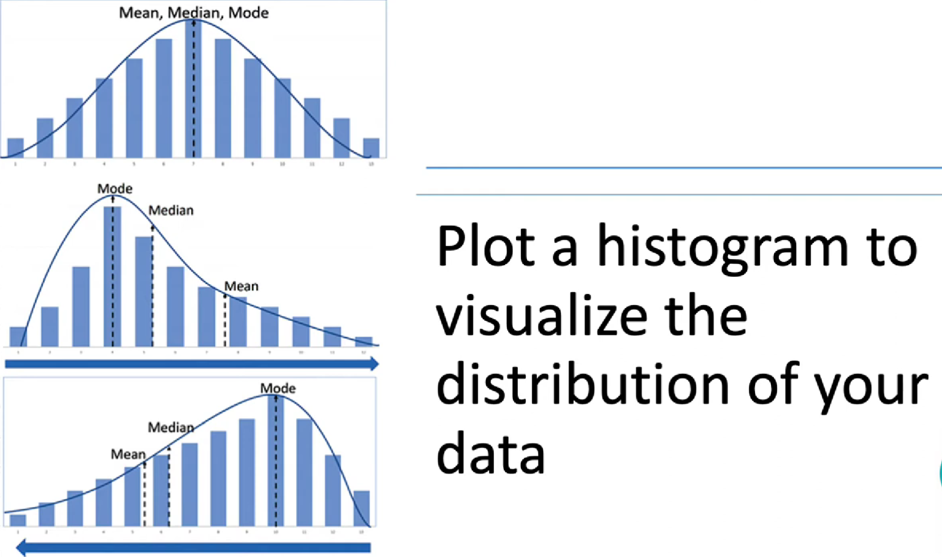

Slide 20
TYPES OF TRANSFORMATION
Logarithmic transformation
Best for highly right skewed data , but can be used for both right and left skewed.
Cannot be applied to zero or negative values.
Most appropriate for continuous variables, such as height or distance

Slide 21
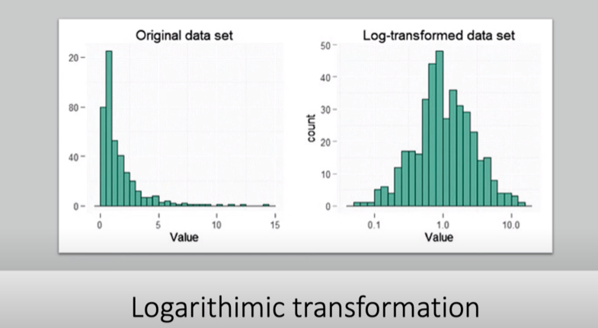

Slide 22
Square – root method
Moderate effect on distribution shape, so it is weaker than the other methods
Normally used for reducing right-hand skewness
Can be applied to zero values
Most commonly applied to count data especially if the values are mostly small.

Slide 23
Reciprocal transformation
Very strong transformation method which can have a dramatic effect on distribution shape
Cannot be used on zero values
Can be applied to negative values , but generally it is most useful when all the values are positive.
Easily interpreted in terms of your original data.

Slide 24
CENTERING AND SCALING
The most straightforward and common data transformation is to center scale the predictor variables.
To center a predictor variable, the average predictor value is subtracted from all the values.
As a result of centering, the predictor has a zero mean.
Similarly, to scale the data, each value of the predictor variable is divided by its standard deviation.
Scaling the data coerce the values to have a common standard deviation of one.
These manipulations are generally used to improve the numerical stability of some calculations.
The only real downside to these transformations is a loss of interpretability of the individual values since the data are no longer in the original units.

Slide 25
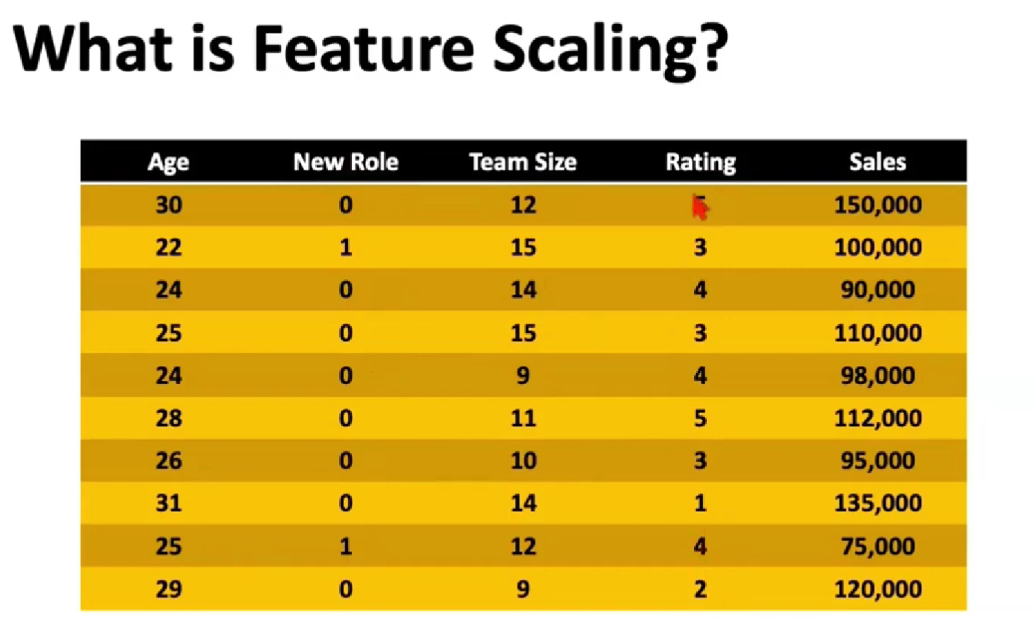

Slide 26
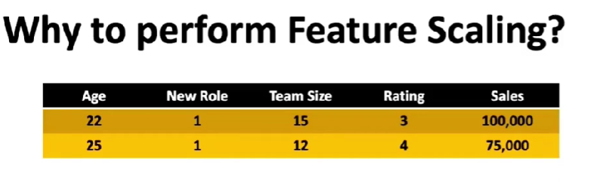
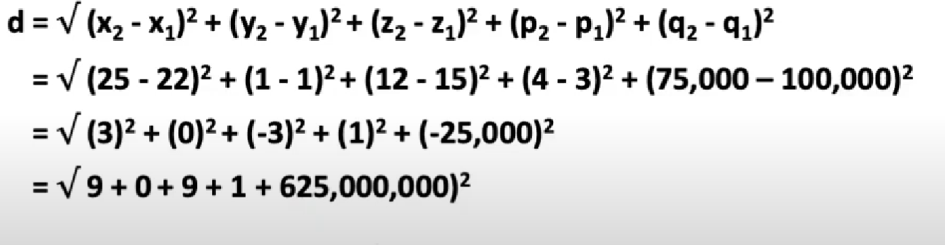
Scaling is the process of bring the features in a comparable scale.

Slide 27
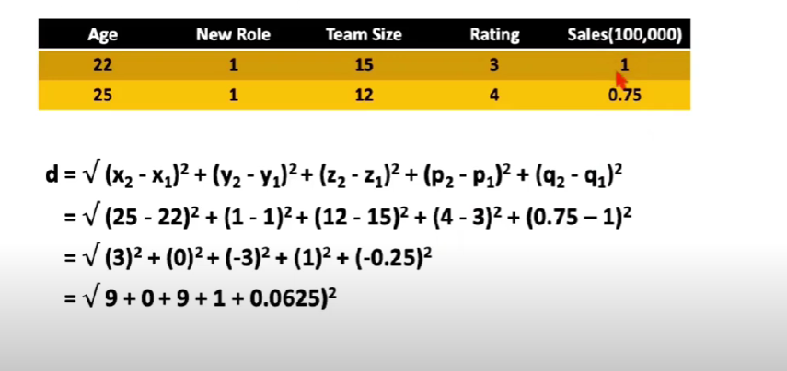

Slide 28
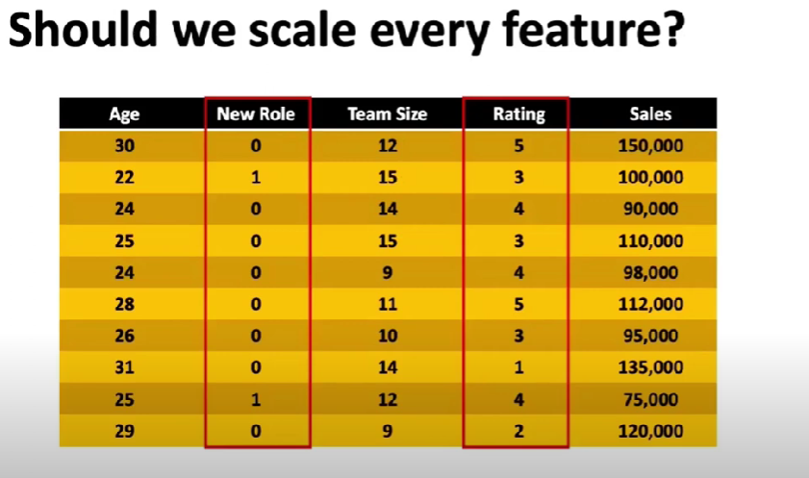

Slide 29
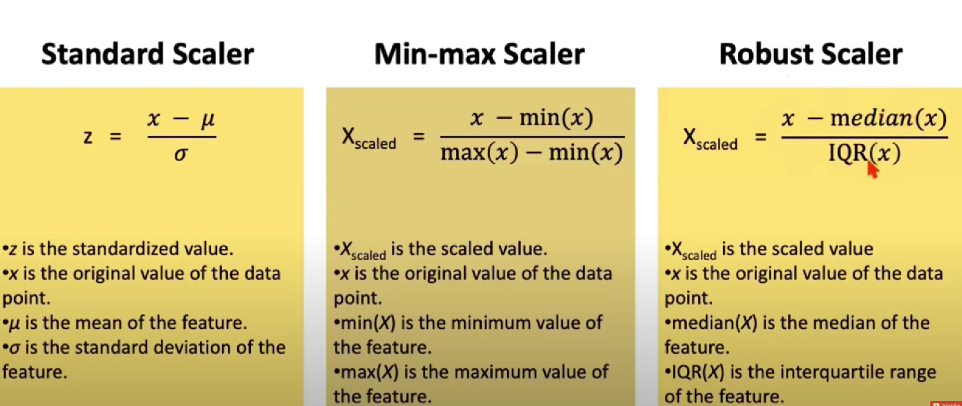

Slide 30
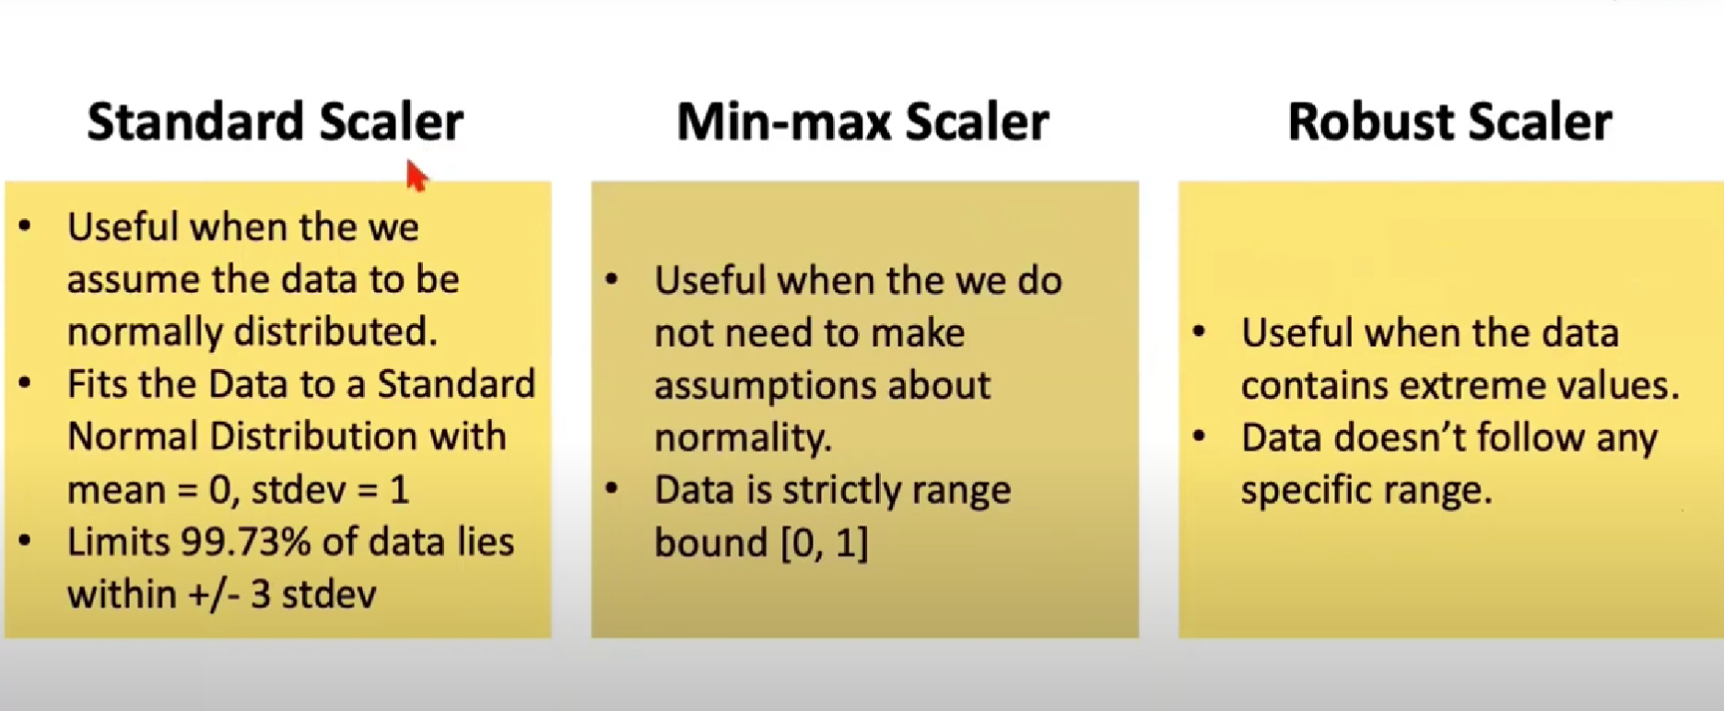

Slide 31
BOX – COX TRANSFORMATION
The Box-Cox transforms non-normal data to normal distribution like data.
The Box-Cox transformation can improve the accuracy of predictions made using linear regression.
This transformation can also make data more understandable and more accessible to work with.

Slide 32
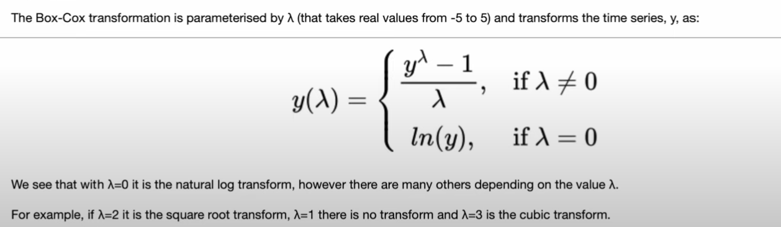
There are three main reasons for using the Box-Cox transformation:
1. To stabilize the variance 2. To improve normality 3. To make patterns in the data more easily recognizable

Slide 33
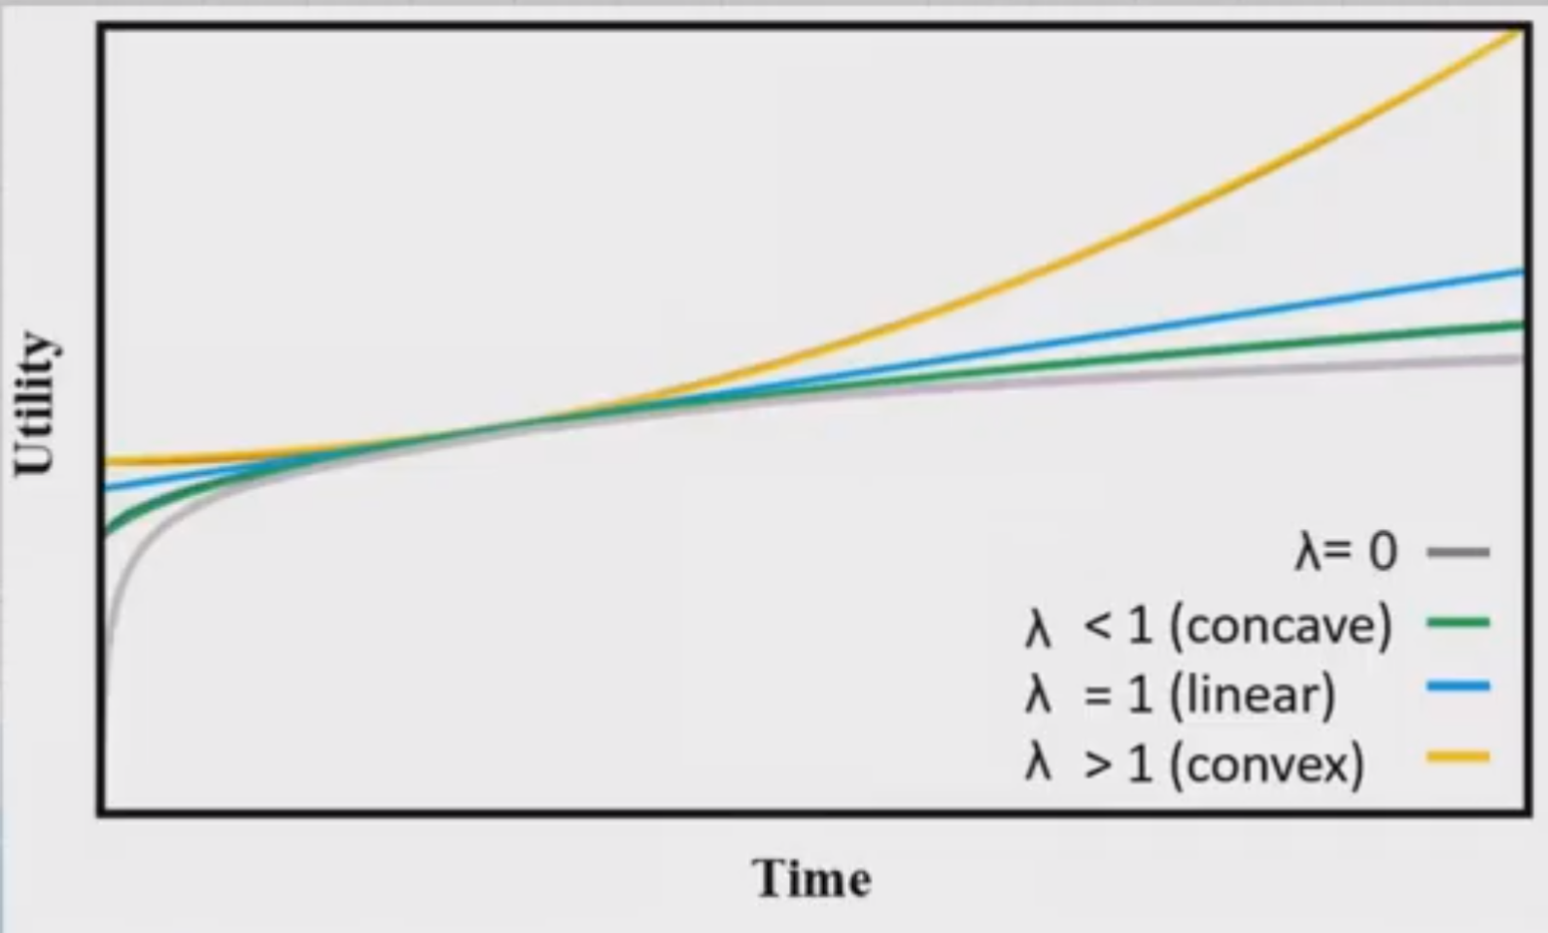
The value of lamda is chosen by seeing which value best approximate the transformed data to the normal distribution.
The optimal value = Best approximation of a normal distribution curve

Slide 34
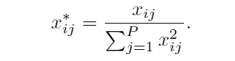
TRANSFORMATION TO RESOLVE OUTLIERS
Outliers as samples that are exceptionally far from the mainstream of the data.
When one or more samples are suspected to be outliers, the first step is to make sure that the values are scientifically valid.
If a model is considered to be sensitive to outliers, one data transformation that can minimize the problem is the spatial sign.
This procedure projects the predictor values onto a multidimensional sphere. This has the effect of making all the samples the same distance from the center of the sphere.
Mathematically each sample is divided by its squared norm.

Slide 35
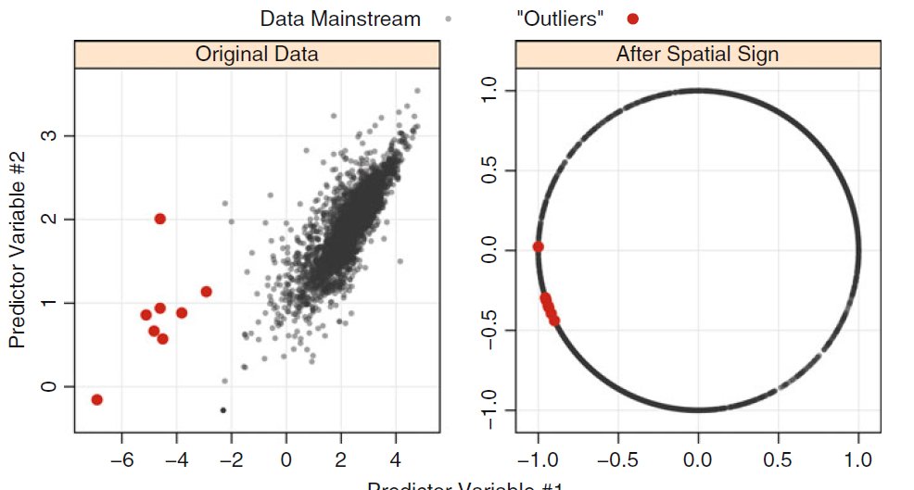
Since the denominator is intended to measure the squared distance to the center of the predictor’s distribution, it is important to center and scale the predictor data prior to using this transformation.

Slide 36
DATA REDUCTION AND FEATURE EXTRACTION
Data reduction techniques are another class of predictor transformations.
These methods reduce the data by generating a smaller set of predictors that seek to capture a majority of the information in the original variables.
In this way, fewer variables can be used that provide reasonable fidelity to the original data.
For most data reduction techniques, the new predictors are functions of the original predictors; therefore, all the original predictors are still needed to create the surrogate variables.
This class of methods is often called signal extraction or feature extraction techniques.

Slide 37
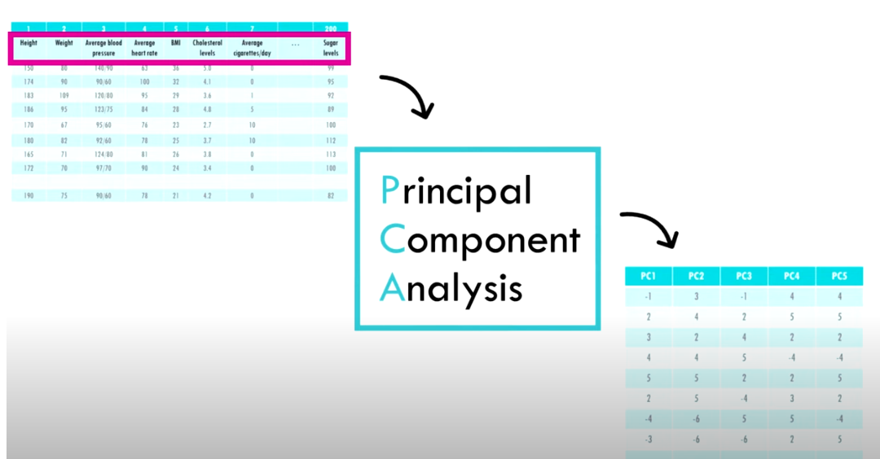
PRINCIPLE COMPONENT ANALYSIS
Principal Component Analysis (PCA) is an unsupervised learning algorithm technique used to examine the interrelations among a set of variables.
PCA is the most widely used tool in exploratory data analysis and in machine learning for predictive models.
The main goal of Principal Component Analysis (PCA) is to reduce the dimensionality of a dataset while preserving the most important patterns or relationships between the variables without any prior knowledge of the target variables.

Slide 38
This method seeks to find linear combinations of the predictors, known as principal components (PCs), which capture the most possible variance.
The first PC is defined as the linear combination of the predictors that captures the most variability of all possible linear combinations.
Then, subsequent PCs are derived such that these linear combinations capture the most remaining variability while also being uncorrelated with all previous PCs.
Mathematically, the jth PC can be written as:
PCj = (aj1 × Predictor 1) + (aj2 × Predictor 2) + · · · + (ajP × Predictor P).
P is the number of predictors. The coefficients aj1, aj2,. . . , ajP are called component weights and help us understand which predictors are most important to each PC.

Slide 39
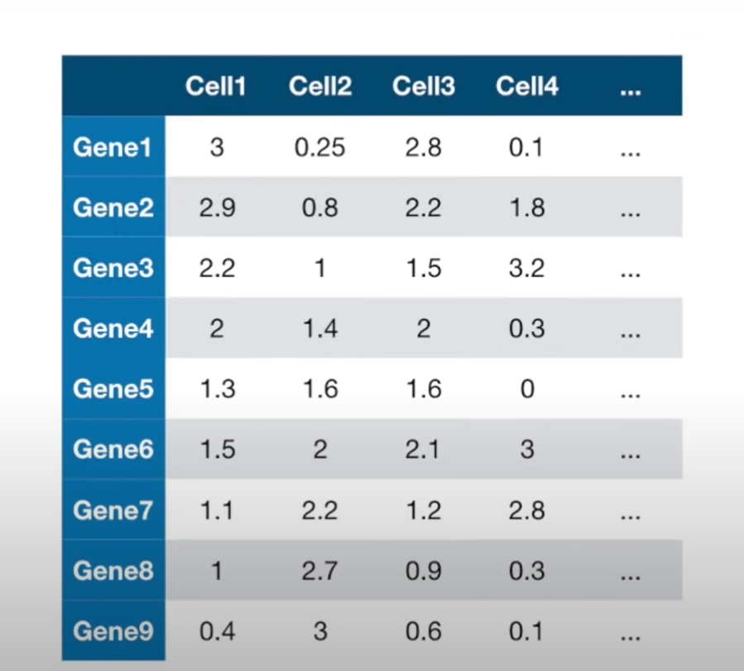


Slide 40
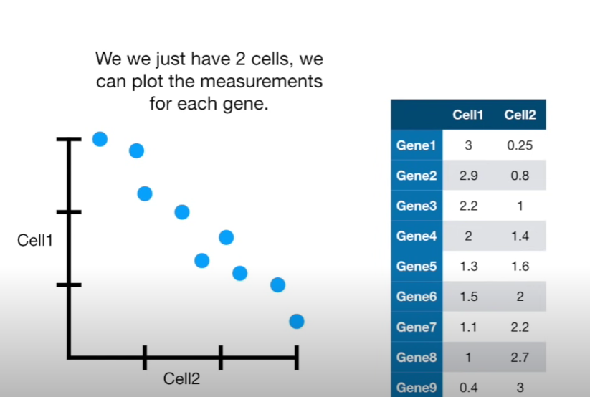

Slide 41
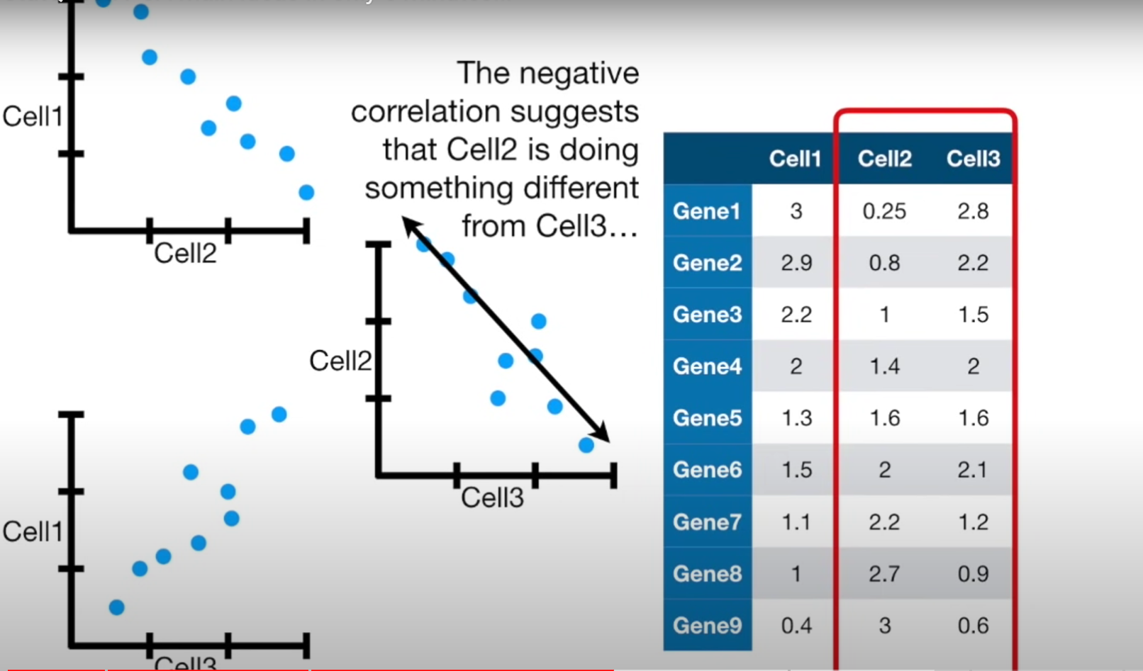

Slide 42
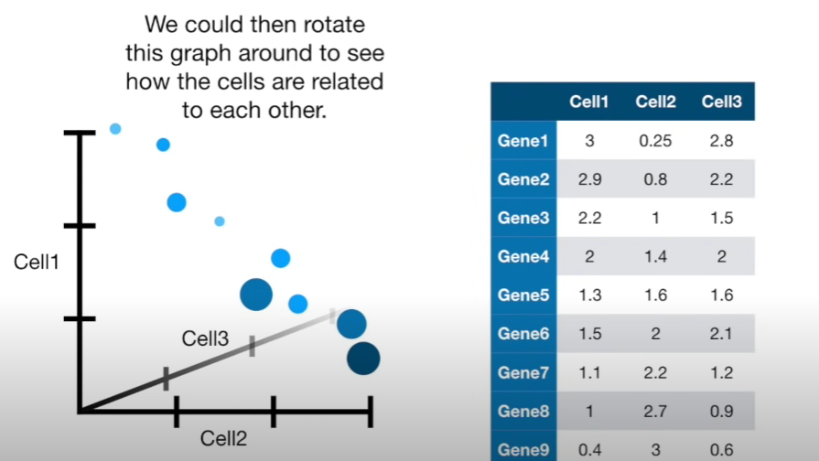

Slide 43
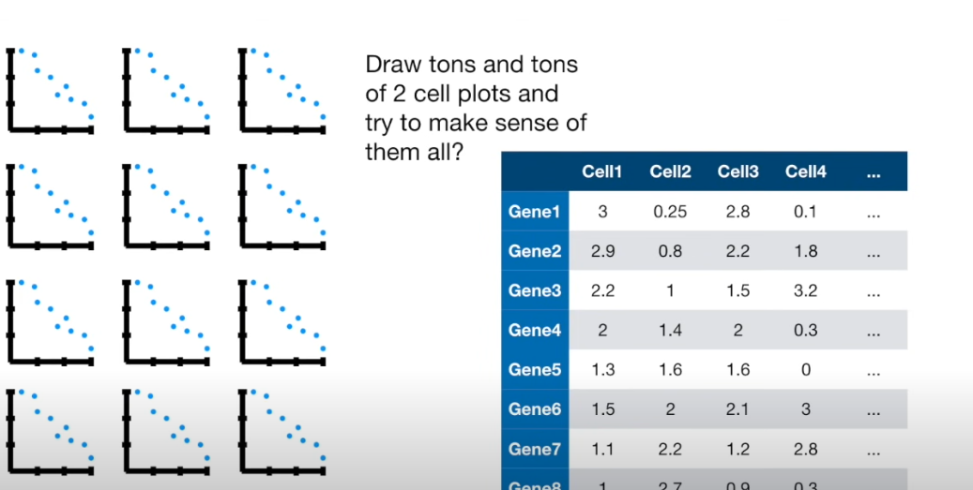

Slide 44
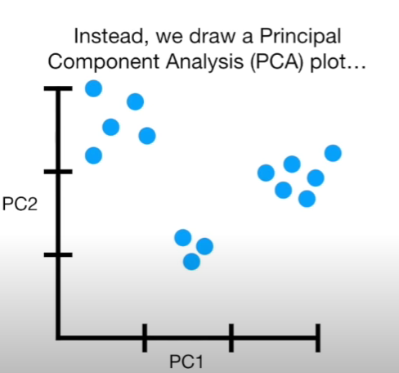

Slide 45
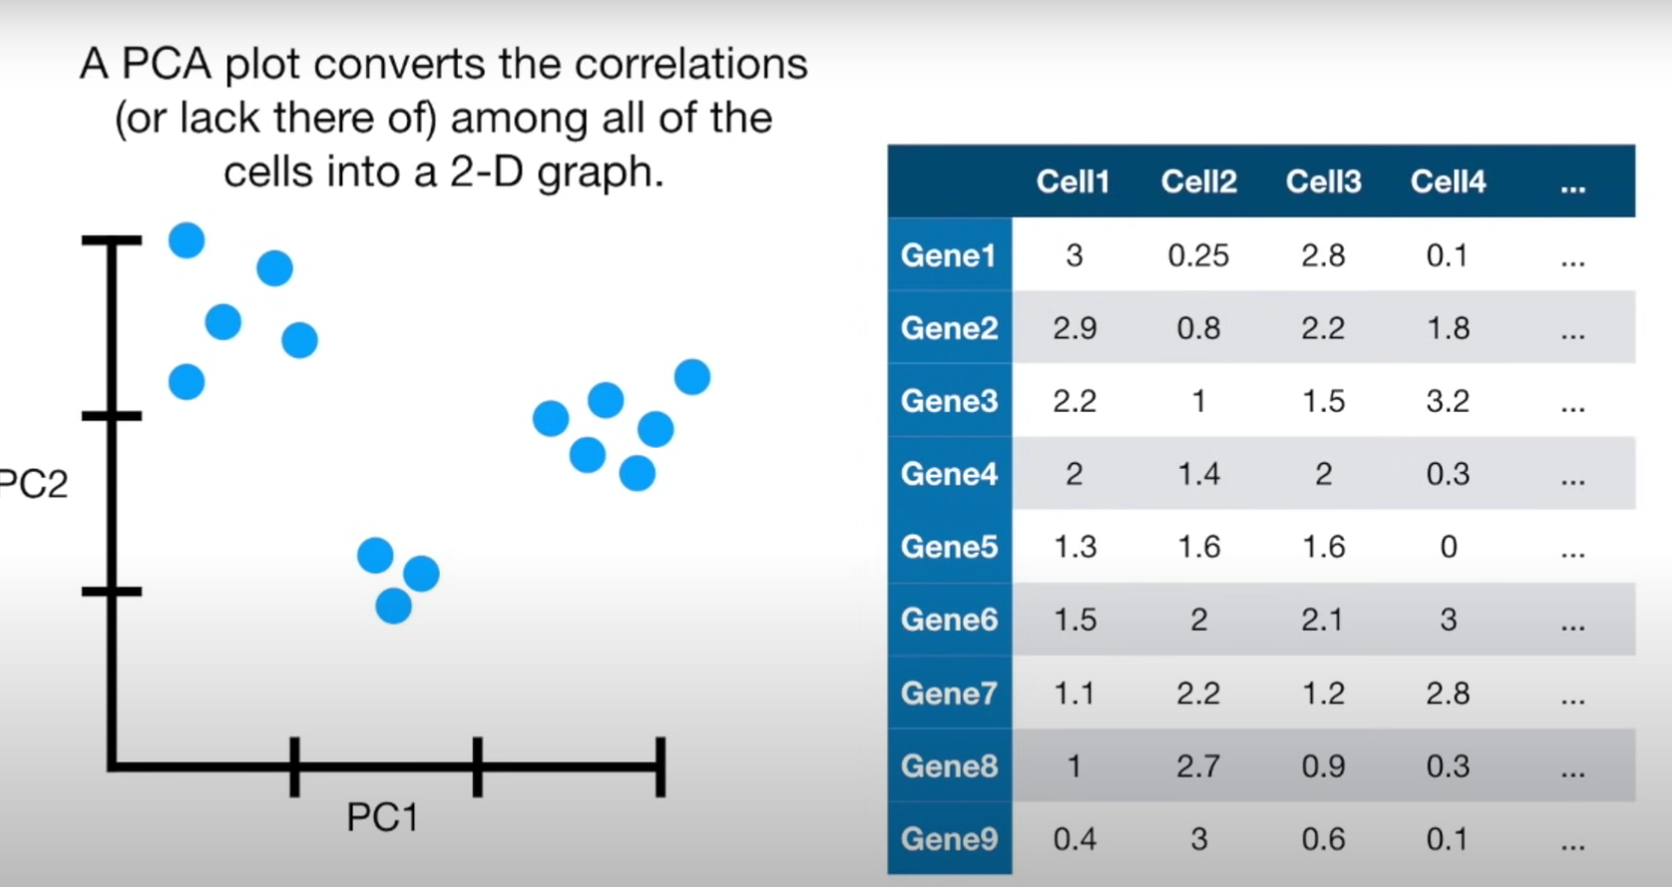

Slide 46
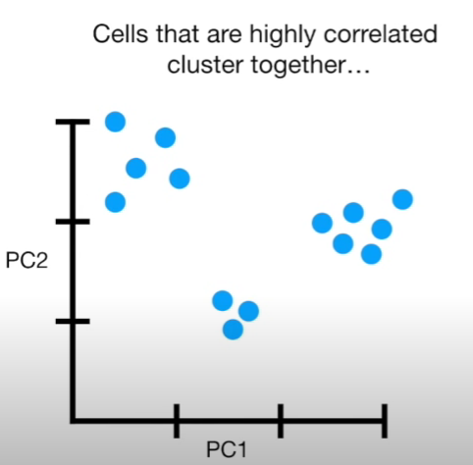

Slide 47
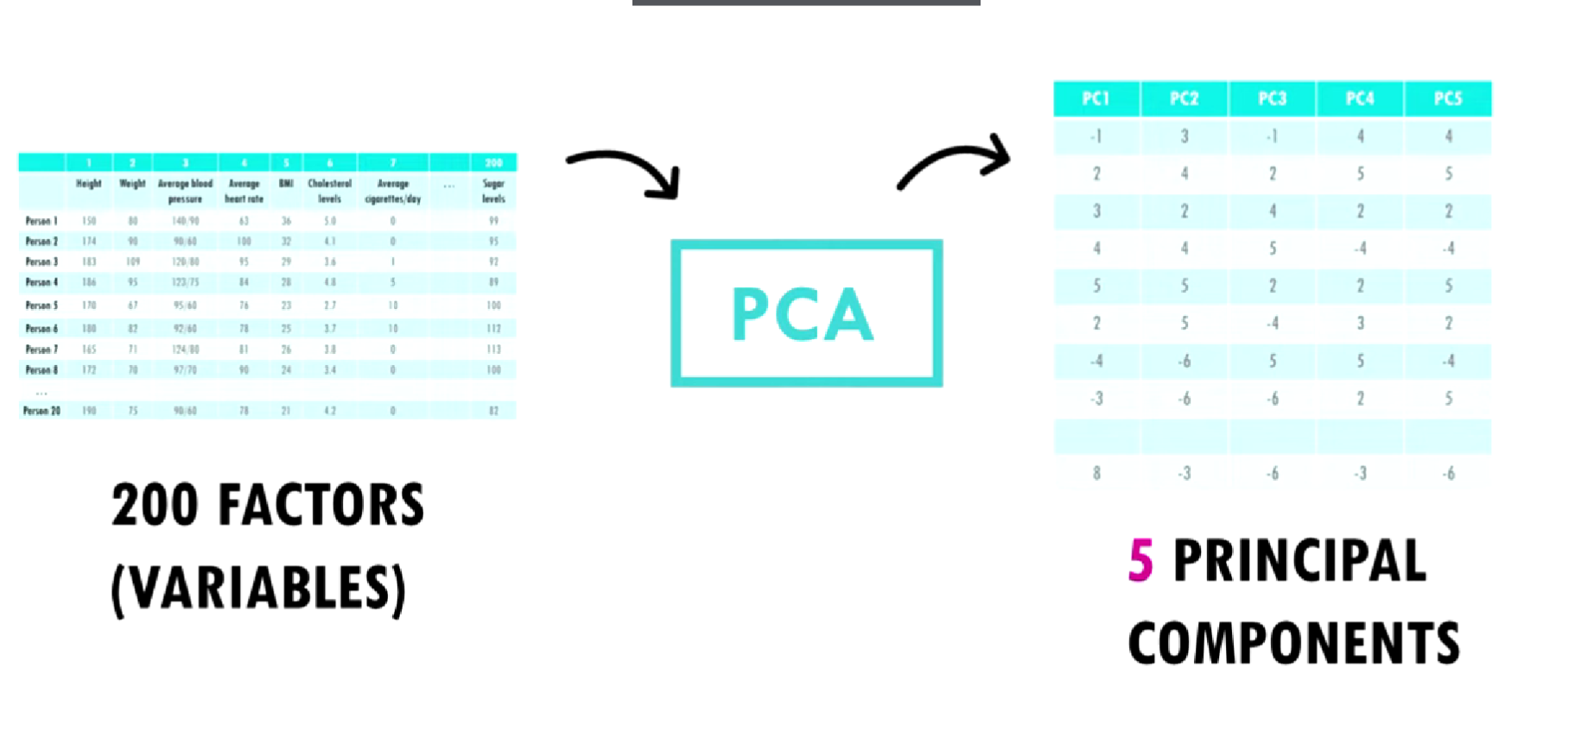

Slide 48
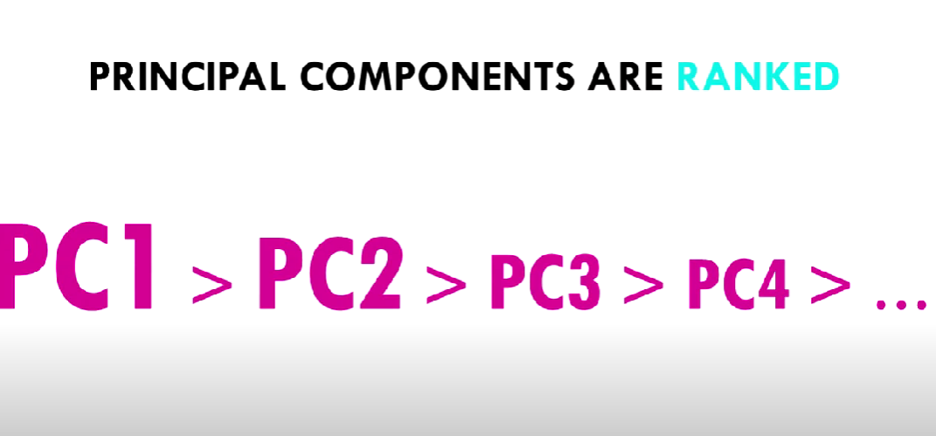

Slide 49
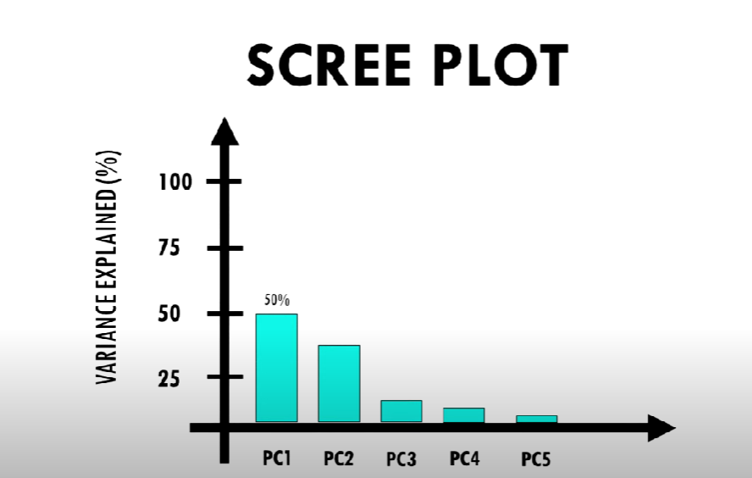

Slide 50
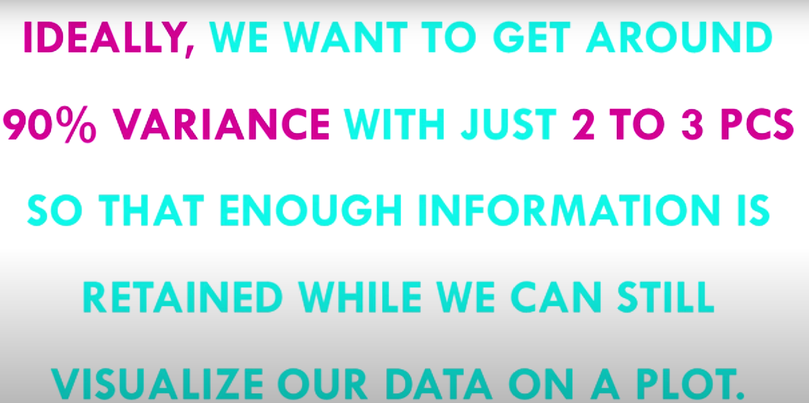

Slide 51
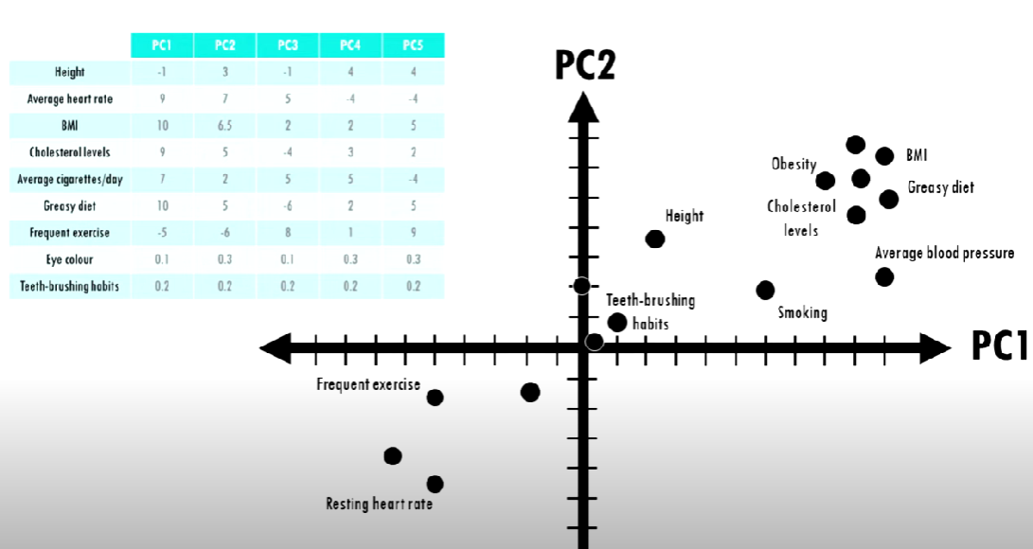
INTERPRETING PC PLOTS

Slide 52
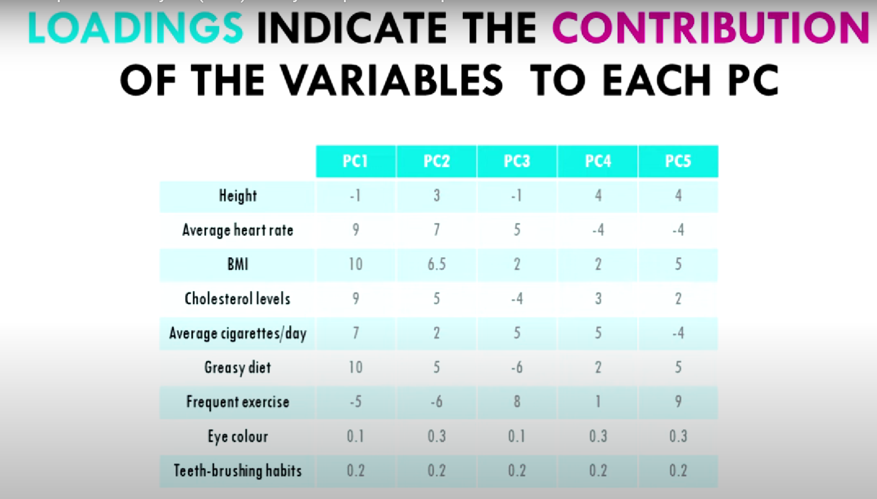

Slide 53
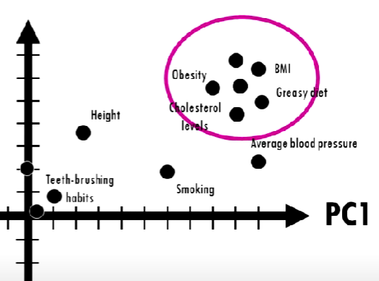
PC loading let us know which variable are influential and how variables are correlated.
Loadings close to zero indicate that the predictor variable did not contribute much to that component.
Variables that are positively correlated are grouped together.

Slide 54
The variables that are negatively correlated are in opposite side of the origin.
The distance from the origin also give information. The further away a variable is from the origin the stronger the impact it has on the model.
Clusters separated by PC1 are more different than clusters separated by PC2

Slide 55
DEALING WITH MISSING VALUES
Missing data can arise in numerous ways, and understanding the mechanism is crucial to appropriate modeling assumptions. In a longitudinal study, if drop-out occurs at a certain time then no additional data are observed after that point.
In many cases some predictors have no values for a given sample. These missing data could be structurally missing, such as the number of children a man has given birth to.
In other cases, the value cannot or was not determined at the time of model building.
It is important to understand why the values are missing.
First and foremost, it is important to know if the pattern of missing data is related to the outcome. This is called “informative missingness” since the missing data pattern is instructional on its own.
Informative missingness can induce significant bias in the model.

Slide 56
Examples:
1. If data on air quality are being collected, there will be missing observations on days on which a pollution monitor was faulty.
2. In a clinical trial, patients may be removed from the study if their longitudinal measurements are below/above some limit.
3. Censoring – measurement instruments may be inaccurate below a lower limit of detection, this limit is then reported.
There are cases where the missing values might be concentrated in specific samples.
For large data sets, removal of samples based on missing values is not a problem, assuming that the missingness is not informative.
In smaller data sets, there is a steep price in removing samples.

Slide 57
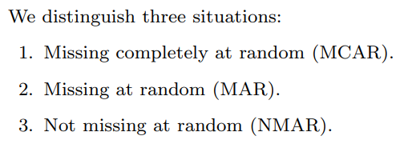
MECHANISUMS OF MISSING

Slide 58
DATA IMPUTATION TECHNIQUES
LIST WISE DELETION
MEAN MEDIAN MODE IMPUTATION
MODEL BASED IMPUTATION
KNN IMPUTER
EXPECTATION MAXIMIZATION IMPUTER
MAXIMUM LIKELIHOOD FUNCTION
REGRESSION
DEEP LEARNING MODELS
DECK IMPUTATION
COLD DECK IMPUTATION
HOT DECK IMPUTATION
LAST OBSERVED CARRIED FORWARD

Slide 59
LIST WISE DELETION
When dealing with data that is missing at random, the entire data point that is missing information can be deleted to help reduce bias.
Removing data may not be the best option if there are not enough observations to result in a reliable analysis.
In some situations, observation of specific events or factors may be required, even if incomplete.

Slide 60
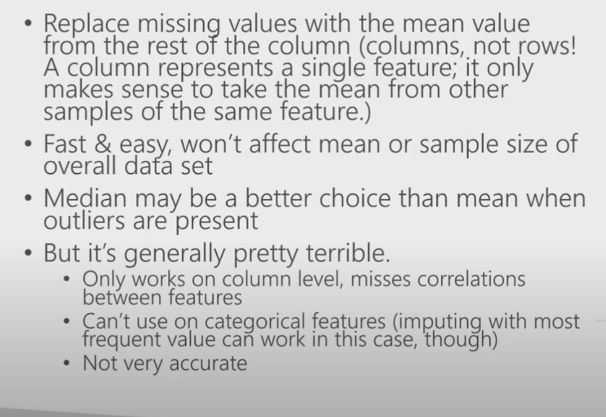
MEAN MEDIAN MODE IMPUTATION

Slide 61
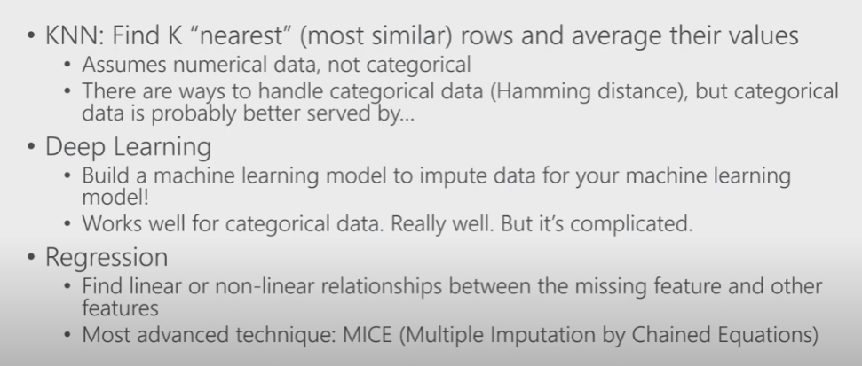
MODEL BASED IMPUTATION

Slide 62
DECK IMPUTATION
Hot-deck. A once-common method of imputation was hot-deck imputation where a missing value was imputed from a randomly selected similar record.
Cold – deck. (e.g., values from a covariate and/or from a previous survey).

Slide 63
LAST OBSERVED CARRIED FORWARD
These options are used to analyze longitudinal repeated measures data, in which follow-up observations may be missing.
In these methods, every missing value is replaced with either the last observed value.
Longitudinal data track the same instance at different points along a timeline.
This method is easy to understand and implement.
However, this method may introduce bias when data has a visible trend.
It assumes the value is unchanged by the missing data.

Slide 64
DATA BINNING
Data binning is a way of pre-processing, summarizing, and analyzing data used to group continuous data into discrete bins or categories. It offers several benefits, such as simplifying data analysis and mitigating the impact of outliers in datasets.
The process involves dividing the range of values into intervals and assigning each data point to an appropriate bin.
It categorizes complex, continuous, and extensive data to decrease noise and reduce the effect of small observation errors on the analysis.
Some widely used bucketing methods are equal-width binning, equal-frequency binning, and custom binning.
Discretization may lead to information loss, over-smoothing, or under-smoothing of datasets, which can further result in misinterpretation and inaccurate outcomes.

Slide 65
Data binning (is also called Discrete binning or bucketing ) is a data pre-processing technique used to reduce the effects of minor observation errors,
The original data values which fall into a given small interval , a bin are replaced by a value represtative of that interval often the central value.
It is a form of quantization.
There is also an option to group categorical values into bins.
This is useful when you have more categorical values in a column than you find necessary.
Binning helps to prevent overfit in the model
Note: A special use case of this binning method is grouping values that are misspelt or differ due to other reasons. For example, if a column contains values like “apple” and “appel”, or “UK” and “United Kingdom”, you can group these values into bins.

Slide 66
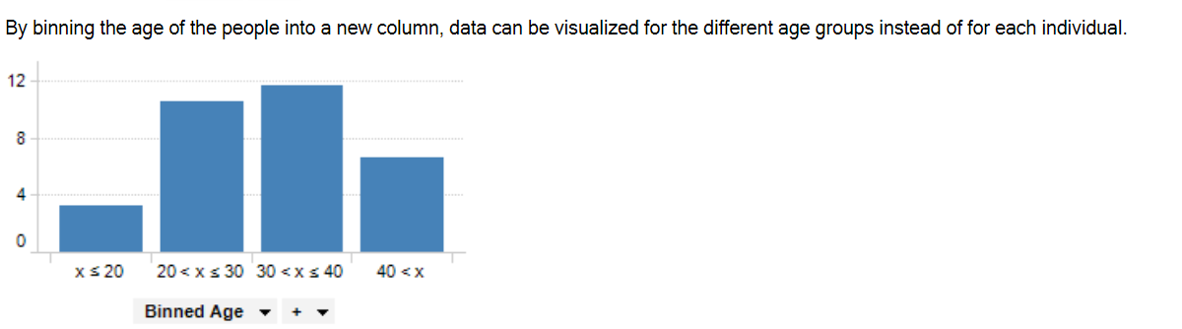
EXAMPLE OF BINNING A CONTINUOUS DATA

Slide 67
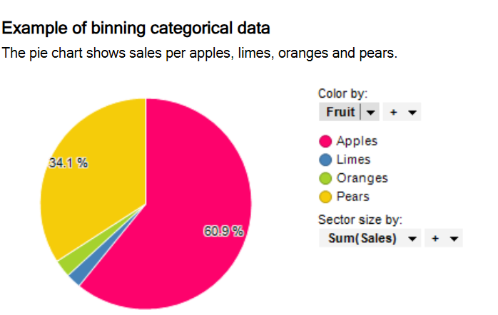
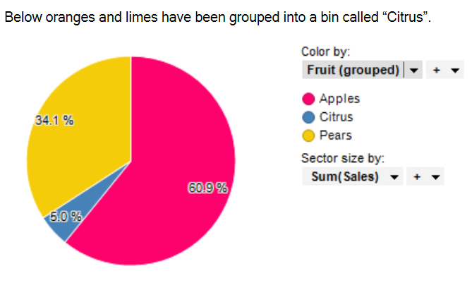

Slide 68
DATA BINNING TECHNIQUES
Equal-Width Binning:
This technique divides the data range into predetermined equal-width intervals or bins.
The bin width can be computed by dividing the data range by the selected number of bins.
While this method is simple and intuitive, it cannot be applied for skewed data distribution.
Equal-Frequency Binning:
In this method, the data is distributed into bins ensuring each bin has roughly the same number of data points.
The data is first sorted, and then an equal number of data points is assigned to each bin.
This approach is useful when it is essential to maintain similar frequencies or distributions across bins. This binning method can effectively tackle outliers and skewed data.

Slide 69
Custom Binning:
Custom binning depends on using specialized knowledge to create intervals for data.
Take educational data analysis as an instance, where you might define certain score intervals to label performance levels like ‘Fail,’ ‘Pass,’ ‘Merit,’ and ‘Distinction.’
This technique serves the special situation of the data very well; it provides deep understanding but requires a strong grasp of its area.
K-means Binning
The sophisticated method of k-means binning uses a clustering algorithm to determine the ranges of bins.
It separates the data into k groups, where each one is a different bin.
This flexible approach adjusts very well to the basic pattern in the dataset we have and shows better performance for more complicated datasets.

